Slide 1
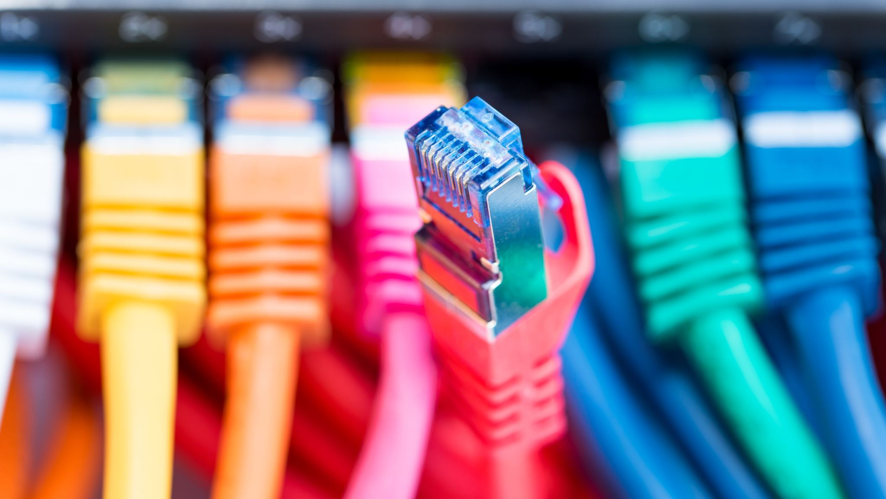
Low-Cost Optical Communications System
By: Team 3 (Jarrod Siglin, Cameron Martinez, Sean Huber, Matthew Simms, Dylan Koch, Dominic Steiner)

Slide 2
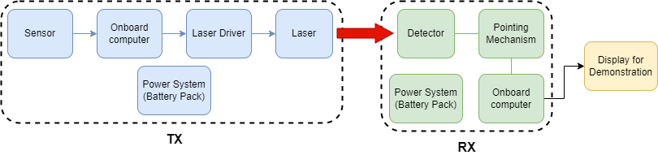
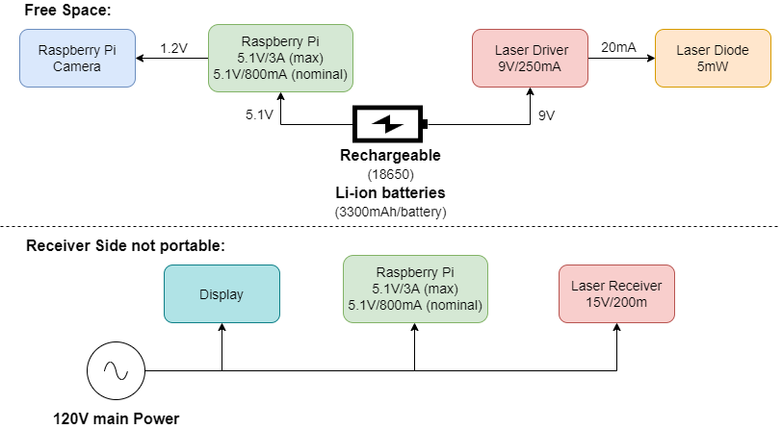
System Architecture and Design

Slide 3
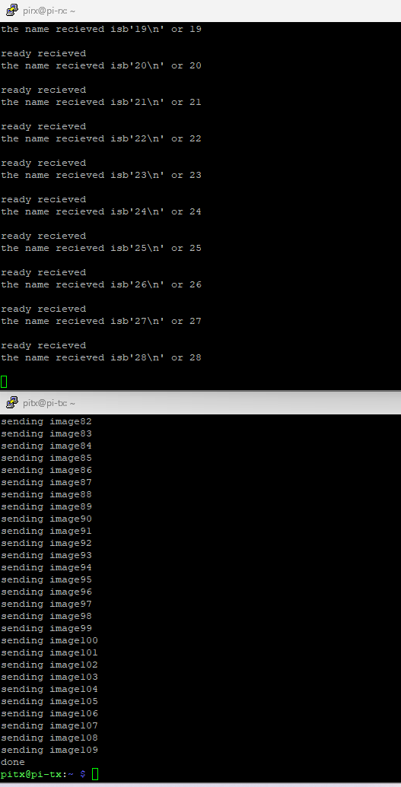
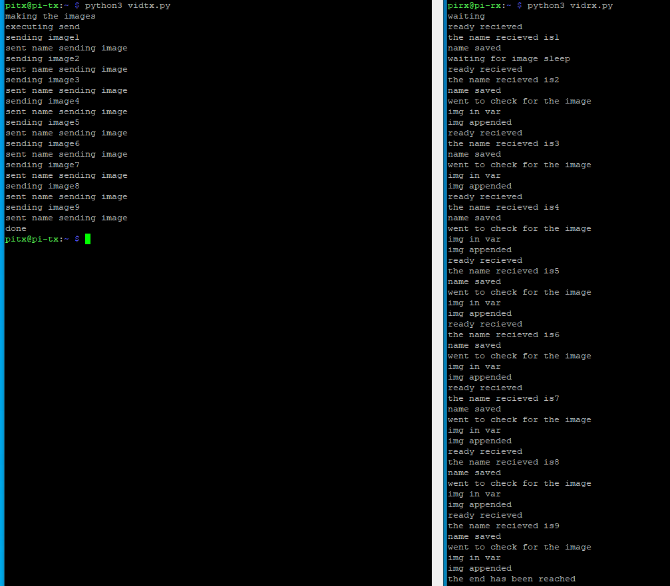
Software
Goals:
Display the images on a flask local webpage
Improve input through multiple possesses

Slide 4
Project Timeline
Planned Sprint 5
Complete modulation with Raspberry Pi's
Integrate camera to transmitter and a visual display to receiver.
Design and create power sub-systems for system.
Actual Sprint 5:
Completed modulation with Rasp Pi
Designed and simulated power sub-system.
Frequency tested driver's ability to send a square wave signal.
Tested Rasp Pi capabilities

Slide 5
Project Timeline
Planned Sprint 6:
Integrate camera to transmitter and a visual display to receiver.
Implement power sub-system.
Use Rasp Pi to modulate driver signal.
Create and define resource guide for future users.

Slide 6
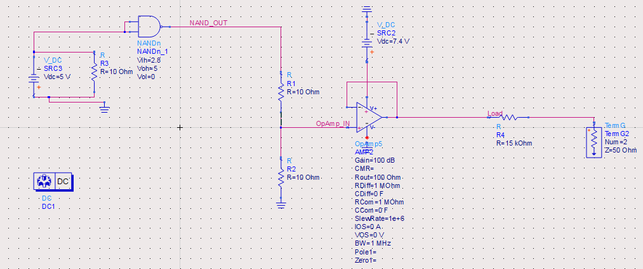
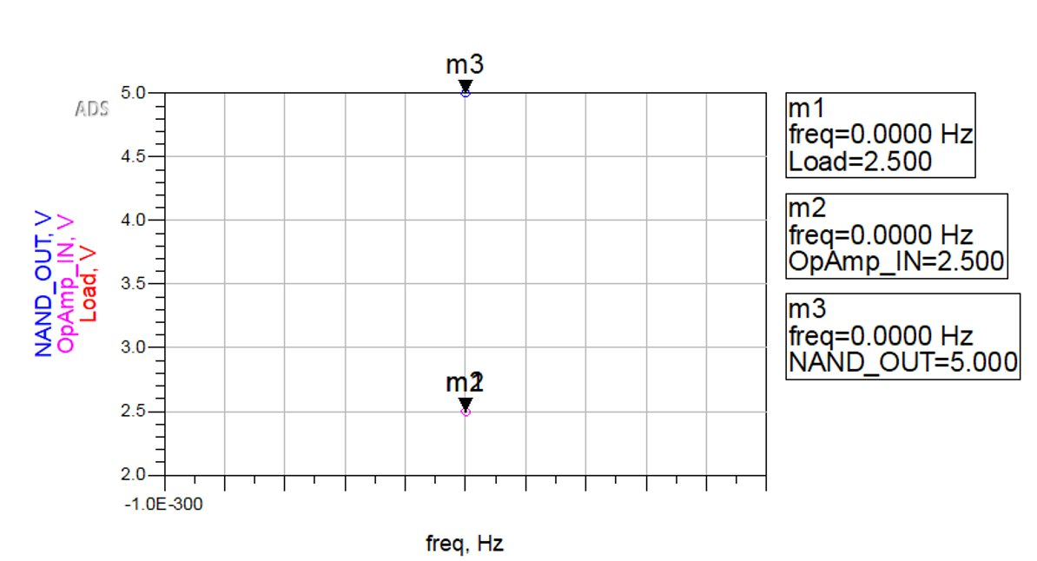
Sprint 5: RasPi voltage scaler circuit design and simulation.

Slide 7
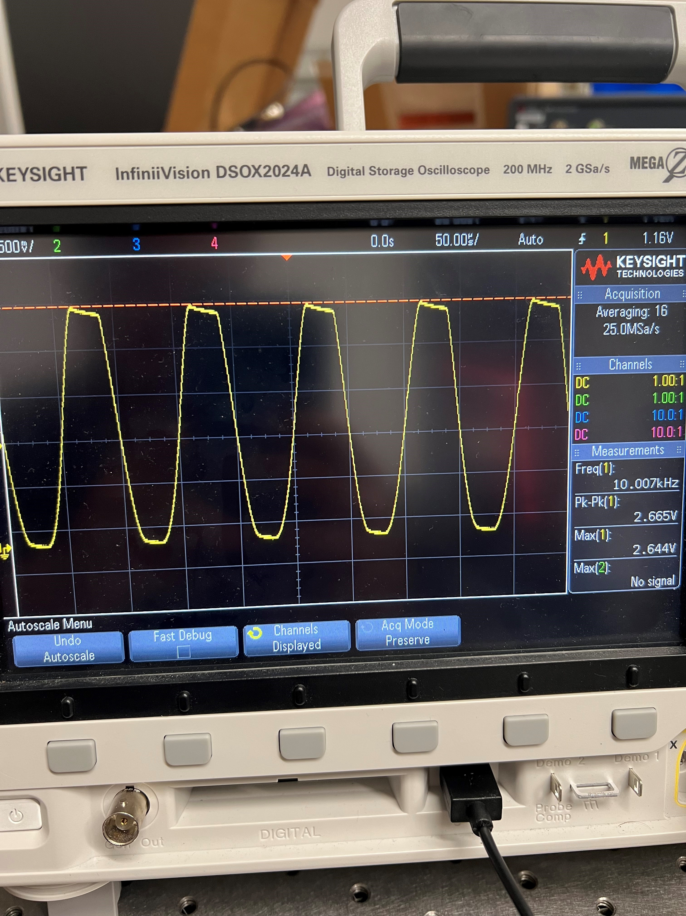
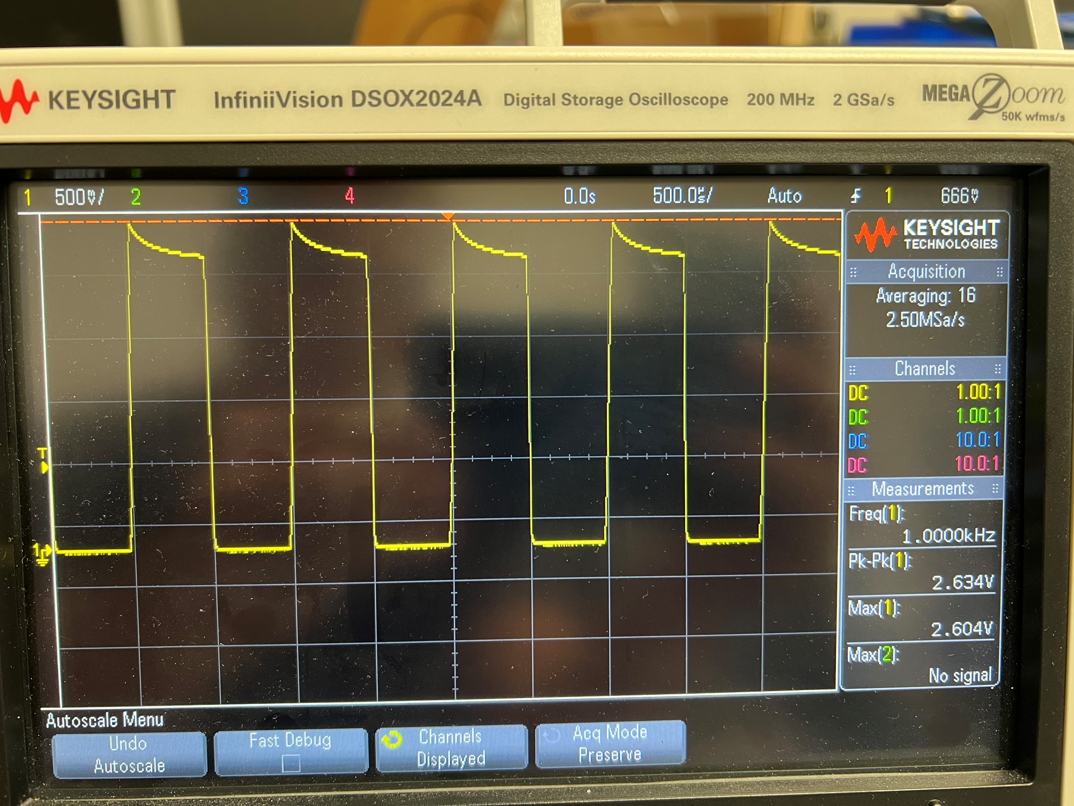
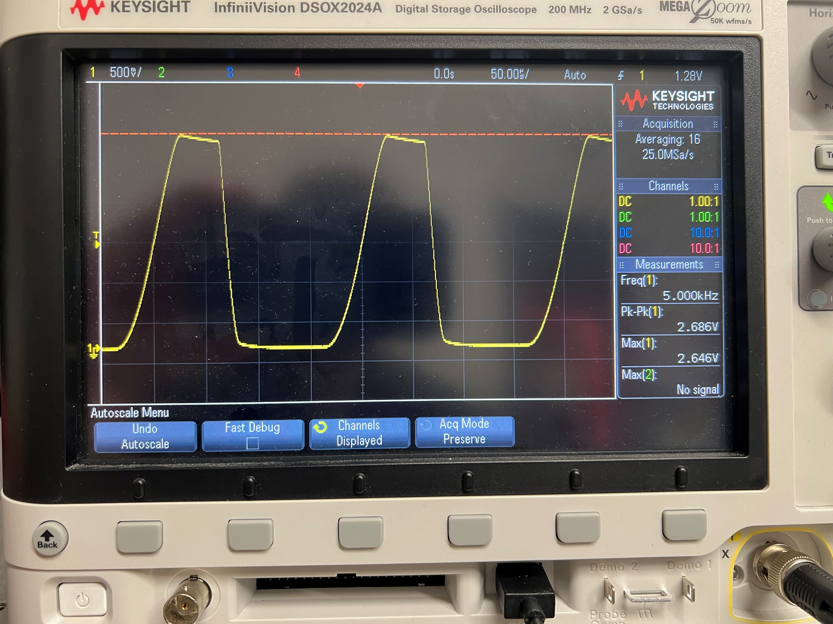
Laser Driver Square Wave Modulation
10 kHz Square Wave
1 kHz Square Wave
5 kHz Square Wave

Slide 8
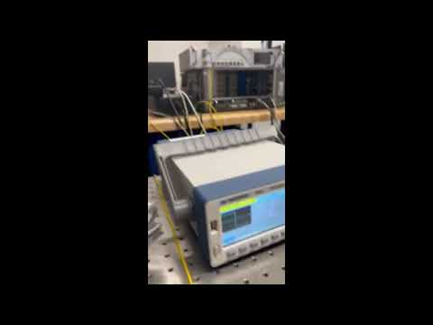
System Setup and Driver Modulation

Slide 9
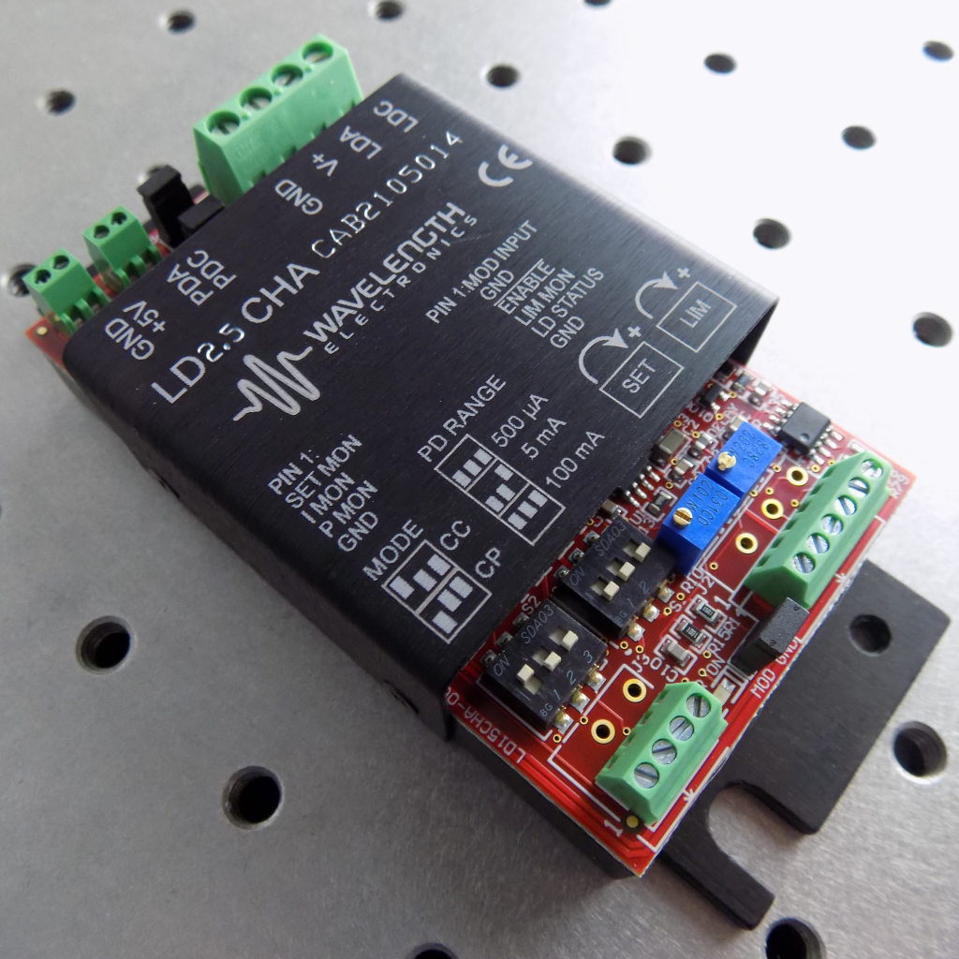
LD2.5CHA 2.5 A / 30 V Laser Diode Driver
Control Electronics: +5 V
Laser Supply: +5 to +30 V
Compliance Voltage: 3 V with 5 VDC power supply; 28 V with 30 VDC power supply
Maximum Output Current: 2.5 A
3dB Modulation Bandwidth: 1 MHz
Package size: 1.125″ x 2.1″ x 4.5″ (28.6 x 53.3 x 114.3 mm)

Slide 10
Questions?
Ask away!

